Slide 1
Servlet Introduction

Slide 2
Objectives
Servlet hierarchy
Servlet Life cycle
HttpServlet
HttpServletRequest
HttpServletResponse
Servlet mapping
Servlets collaboration
<number>/41

Slide 3
What a Servlet is
Servlets are small Java programs that run on a Web server and help to build dynamic Web pages.
Servlets receive and respond to requests from Web clients, usually across HTTP, the HyperText Transfer Protocol.
Java Servlet technology was created as a portable way to provide dynamic, user-oriented content.
  Because the servlet is running on the server side, it does not require any Java-support from Web browser
  Servlet is multi-thread
  Controller
<number>/41

Slide 4
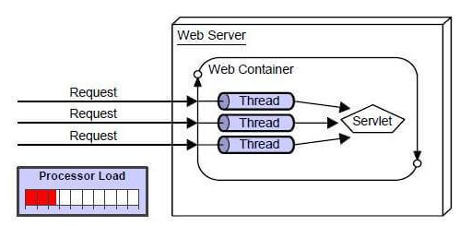
What a Servlet is??????????????
  Servlet is multi-thread
<number>/41
Notes:
?????

Slide 5
What a Servlet is...
Web
Server
Browser
Client
Request
Internet HTTP Protocol
Response
ServletContainer
Servlets
Database
<number>/41

Slide 6
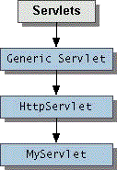
Hierarchy of Servlet class
The javax.servlet package provides interfaces and classes for writing servlets
When a servlet accepts a call from a client, it receives two objects:
  ServletRequest, which encapsulates the communication from the client to the server.
  ServletResponse, which encapsulates the communication from the servlet to the client.
<number>/24

Slide 7
The Servlet interface
At the heart of servlet architecture is the interface javax.servlet.Servlet.
  It provides the framework for all servlets.
The Servlet interface defines five methods. The three most important are as follows:
  init() method—Initializes a servlet
  service() method—Receives and responds to client requests
  destroy() method—Performs cleanup
All servlets must implement this interface, either directly or through inheritance.
<number>/41

Slide 8
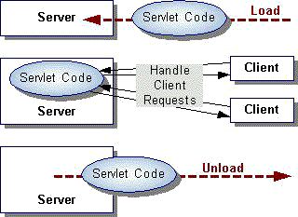
The Servlet Life Cycle
init
service
destroy
<number>/41

Slide 9
Servlet life cycle
The init() method is where the servlet's life cycle begins.
  It is called by the server immediately after the servlet is instantiated.
  It is called only once.
  public void init(ServletConfig config) throws ServletException;
  In the init() method, the servlet creates and initializes any resources, including data members, that it will be using while handling requests.
<number>/41

Slide 10
Servlet life cycle
The service() method handles all requests sent by a client.
  The entry point for executing application logic in a servlet
  It cannot start servicing requests until the init() method has been executed.
  The service() method implements a request and response paradigm.
  We should never implement this method directly if extending from HttpServlet
<number>/41

Slide 11
Servlet life cycle
The destroy() method signifies the end of a servlet's life.
  When a service is being shut down, it calls the servlet's destroy() method.
  This is where any resources that were created in the init() method will be cleaned up.
  If you have an open database connection, you should close it here.
  This is also a good place to save any persistent information that will be used the next time the servlet is loaded.
The getServletConfig() method returns the servlet's ServletConfig object, which contains the servlet's startup configuration and initialization parameters.

Slide 12
The ServletRequest
ServletRequest encapsulate information about the client's request includes: parameter name/value pairs, attributes, and an input stream.
  getAttribute(String name) returns value of the object keyed by the name for the current request.
  getParameter(String name) method returns the value of the requested parameter.
  If the parameter has or could have more than one value, use the getParameterValues() method.
  getRemoteAddress() method returns a String representing the IP address of the client sending the request.
<number>/41

Slide 13
The ServletResponse
ServletResponse sends MIME data back to the client from the servlet's service method.
  getWriter() method returns a print writer used for writing formatted text to the response object.
  getOutputStream() method returns an output stream used for writing binary data to the response.
  setContentType() method sets the content type of the current response.
    This method must be called before calling the getWriter() or getOutputStream() methods.
<number>/41

Slide 14
HttpServlet
The HttpServlet class has already implemented the service() method.
protected void service(HttpServletRequest req, HttpServletResponse resp)throws ServletException, IOException;
When the HttpServlet.service() method is invoked, it reads the method type stored in the request and determines which method to invoke based upon this value.
  If the method type is GET, it will call doGet(). If the method type is POST, it will call doPost().
  These are the methods that you will want to override
  Typically, we should not override the service() method, but the doPost() and/or doGet() method
<number>/41

Slide 15
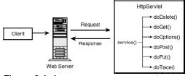
HttpServlet
<number>/41

Slide 16
HttpServlet Class
The protocol defines a set of text-based request messages called HTTP ‘methods’ implemented in HttpServlet class:
  doGet Called by the server (via the service method)to allow a servlet to handle a GET request
  doHead Receives an HTTP HEAD request from the protected service method and handles the request
  doPost called by the server to allow a servlet to handle post request
  doPut Called by the server (via the service method) to allow a servlet to handle a PUT request
  doDelete Called by the server (via the service method) to allow a servlet to handle a DELETE request
  doTrace Called by the server (via the service method) to allow a servlet to handle a TRACE request
  doOptions Called by the server (via the service method) to allow a servlet to handle a OPTIONS request
<number>/41

Slide 17
The HttpServletRequest
HttpServletRequest provides the HttpServlet.service() to access HTTP header information sent by the client.
  getQueryString() method returns the query string from the request.
  getSession(true) method returns the session associated with the request. If there is no valid session and the boolean parameter passed in is true, then it will create a new session.
  getRemoteUser() method returns the name of the user making the request. If the name is not available, null is returned.
  getMethod() method returns the HTTP method used by the client request.
  setAttribute(name, object) save object into request with name
  getAttribute(name) return the object referenced by name
  attributes pass informations from one servlet to another
<number>/41

Slide 18
The HttpServletResponse
HttpServletResponse
  encodeURL() method encodes the passed-in String and returns it. If no changes are necessary, then it simply returns the String.
  sendError(int er, String msg) method sends an error to the client in the response object. The error consists of the int status code and a String message.
  sendRedirect(url) method redirects the client to the passed-in URL, which must be an absolute URL.
<number>/41

Slide 19
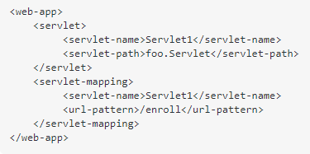

Servlet mapping-Invoke a Servlet
There are two ways to invoke a servlet.
  Servlet mapping in web.xml: calling by url-pattern
  Mapping by @webServlet annotation
<number>/41
Notes:
Ví dụ file word

Slide 20
A Simple Servlet
import java.io.*;
import javax.servlet.*;
import javax.servlet.http.*;
public class FirstServlet extends HttpServlet {
public void doGet(HttpServletRequest request,
HttpServletResponse response)
throws ServletException, IOException
{
PrintWriter out = response.getWriter();
out.println(“<h1>First Servlet</h1>");
}
}
<number>/41

Slide 21
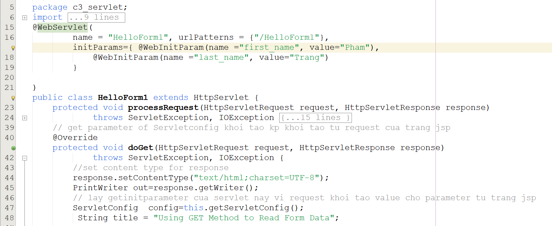
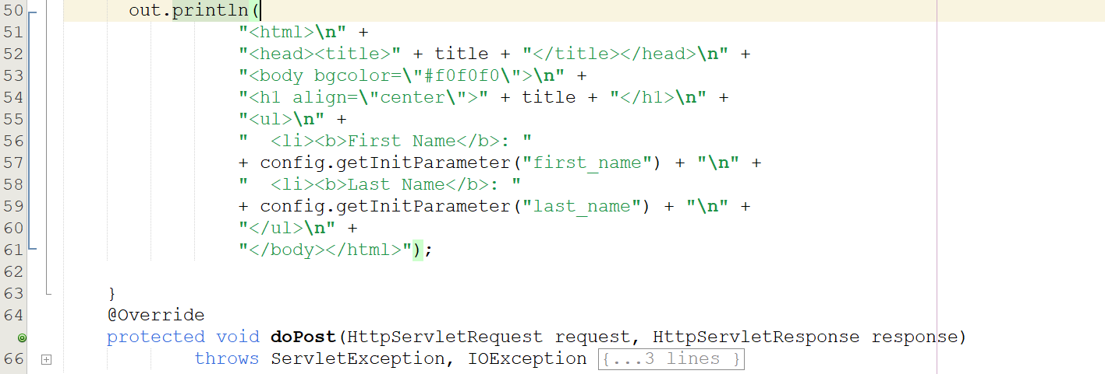
<number>/24

Slide 22
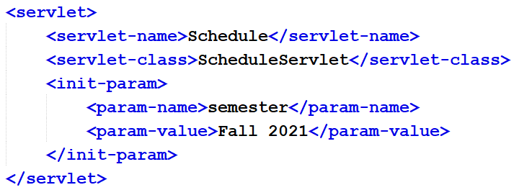
Servlet init parameter
Init parameters of a servlet can help to specify important aspects that are going to be handled during requests service.
  Semester code for a servlet to retrieve student’s timetable
Declare in web.xml for servlet or anotation
@WebServlet(name = “Schedule", urlPatterns = {"/schedule"}, initParams={ @WebInitParam(name=“semester", value=“Fall 2021")})
String semCode=getInitParameter(“semester”);
<number>/41
Notes:
Syntax of @WebInitParam Annotation:
@WebInitParam (
name = <name>,
value = <value>,
description = <value>
)
@WebServlet( initParams = {
@WebInitParam(name = "emailSupport1", value = "abc@example.com"),
@WebInitParam(name = "emailSupport2", value = "tom@example.com") })
@WebServlet( name = "Schedule",urlPatterns = {"/schedule"},
initParams = {
@WebInitParam(name = "user", value = "sa"),
@WebInitParam(name = "pass", value = "abc@123")
}
)

Slide 23
Servlet Collaboration
A servlet can receive a request from client and delegates the processing to another servlet.
There are 2 solutions for this collaboration:
  Using servlet chaining:
    configure the servlet container to chain the servlet;
    not supported by servlet API specification
  Using Request Dispatching
    Allow a servlet to dispatch a request to another servlet for generating the response
    The RequestDispatcher used for this purpose
<number>/41

Slide 24
RequestDispatcher
A servlet obtains a RequestDispatcher object for a resource by calling:
  ServletContext.getRequestDispatcher(String URLpath)
  ServletRequest. getRequestDispatcher(String URLpath)
  ServletContext.getNameDispatcher(String name)
void forward(request,response)
    Forwards a request from a servlet to another resource
    The request and response parameters must be the same objects as were passed to the calling servlet
void include(request,response)
    Includes the content of a resource (servlet, JSP page, HTML file) in the response
<number>/41

Slide 25
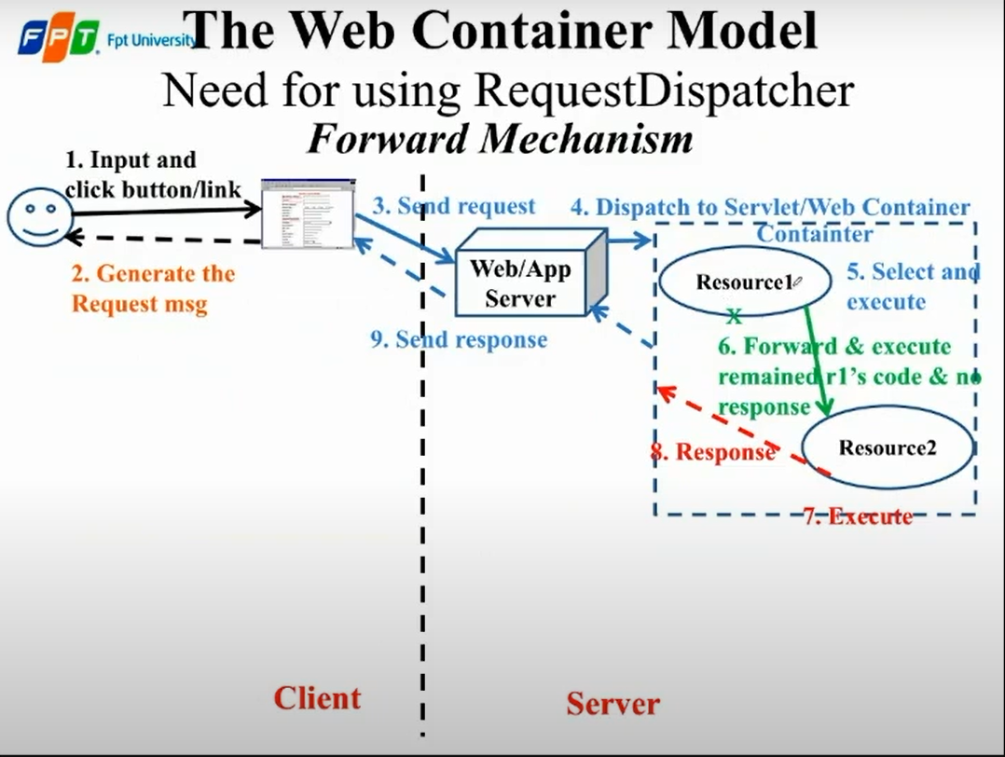
<number>/24

Slide 26
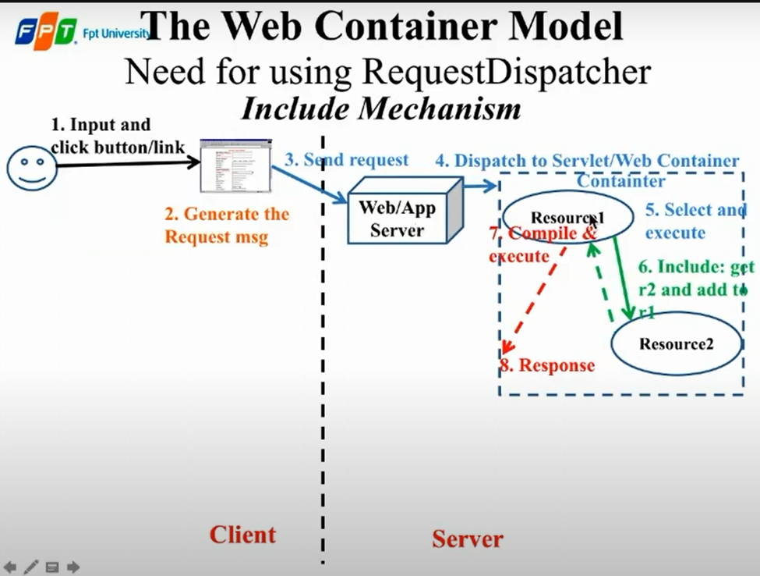
<number>/24

Slide 27
Summary
Servlets concept
Servlets hierarchy structure
Servlet life cycle
HttpServlet
  HttpServletRequest
  HttpServletResponse
Servlet Init parameter
Servlet mapping
Servlet Collaboration
<number>/41

Slide 28
Constructive question
How many servlet instance are instantiated to serve many request from multi client?
When the servlet's init() method is invoked?
A web application allows users to log in with different roles. Try to come up the solution to meet this requirement that is most convenient for users
Write a single servlet that responds to user login requests with no support components
<number>/24

